Slide 1
Randomised Matrix Multiplication and Algorithms in Numerical Linear Algebra
Notes:
Khushei
Basic idea of what the topic is, what fields it finds applications in
How we are going to go about explaining it

Slide 2
Understanding the problem
01
Naive approach to matrix multiplication is a 3 loop process
02
Complexity is of the order O(n³), O(mnp) specifically, if the matrices are of the order m x n and n x p
03
This proves to be very expensive in time with large matrices when m, n and p values run in thousands
Notes:
Khushei

Slide 3
Project objective
Reduce time complexity of matrix multiplication operation by
applying randomised sampling to the rows and columns of the
matrix which will be used for the operation.
Sampling can be effective and can scale to massive data to get a closely approximate answer.
Notes:
Khushei
First three paragraphs of report

Slide 4
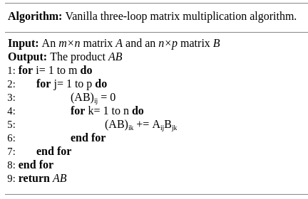
Report
Time complexity :
O(mnp) ~ O(n³)
Notes:
Khushei

Slide 5
Report
The new idea is that we can view the product AB as a sum of rank one matrices.
AB can also be written as the sum of outer product of the first column A (A_{*1}) and the first row of B(B_{1*}), outer product of the second column A (A_{*2}) and the second row of B(B_{2*}), and so on.
Notes:
Khushei
When you reach probability part, go to next slide

Slide 6

Report
If p_{i} is the probability of the i^{th} term, then sum of p_{i} from i=1 to n is 1; n is the number of terms.
To get the probability values, we sample c times. And in each time of sampling, we pick one of the rank 1 matrices.
After normalization,
is obtained as the estimator of AB.
Notes:
Khushei

Slide 7
Report
So the algorithm basically consists of the following two steps:
Pick c columns of A with replacement to form the matrix C and the corresponding rows of B to create R.
Calculate CR and return.
So AB~CR.
Notes:
Mugdha

Slide 8
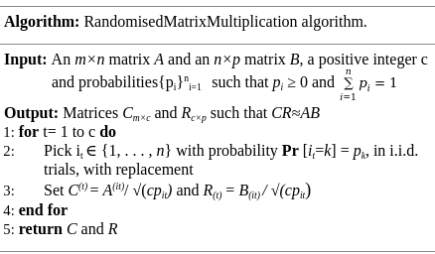
Report
Notes:
Mugdha

Slide 9



Report
Details of how to find the probabilities for each term:
First method would be to choose all the p_{i} values as 1/n.
Second method of weighing by row and column norm, i.e,
the respective normalized values and
are put in C and R, respectively.
Probability vector
Notes:
Mugdha

Slide 10


Report
A
B
We can write this in terms of a sampling matrix S of size nxc. This sampling matrix will have, for every column, a single non-zero entry j_{t} at the position (j_{t}, t) whose value will be
, i.e,
It is now easy to visualize that CR = (AS)(S^{t}B). S is a common projection matrix for A and B.
≈
C
R
Notes:
Mugdha

Slide 11
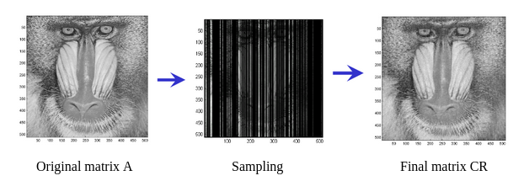
RESULTS
Screenshots and Graphs
Notes:
Mahesh

Slide 12
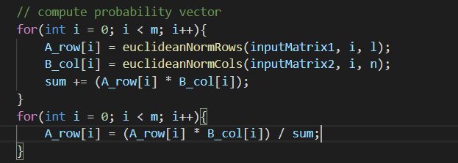
Generates the probability vector
Notes:
Mahesh

Slide 13
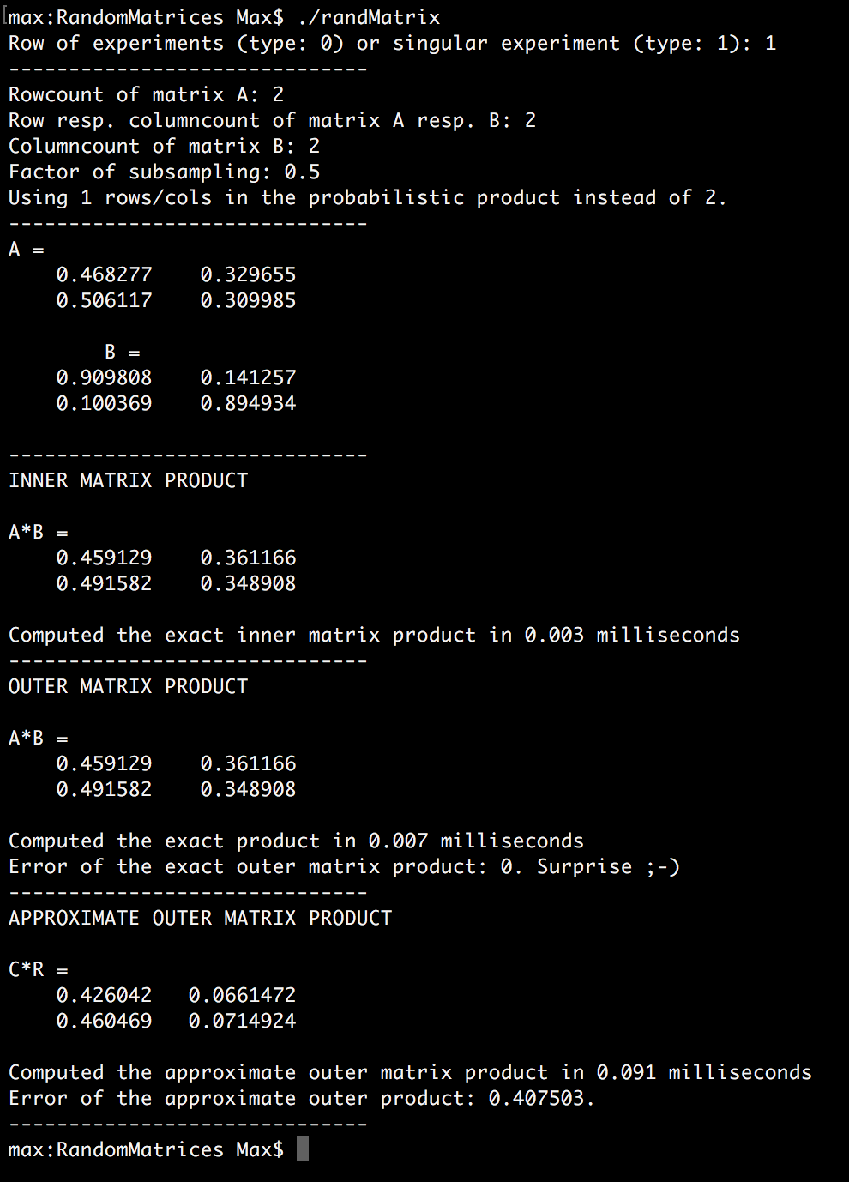
Output generated for n=2, using custom sampling method
Error due to approximation: 0.407503
Notes:
Mahesh

Slide 14
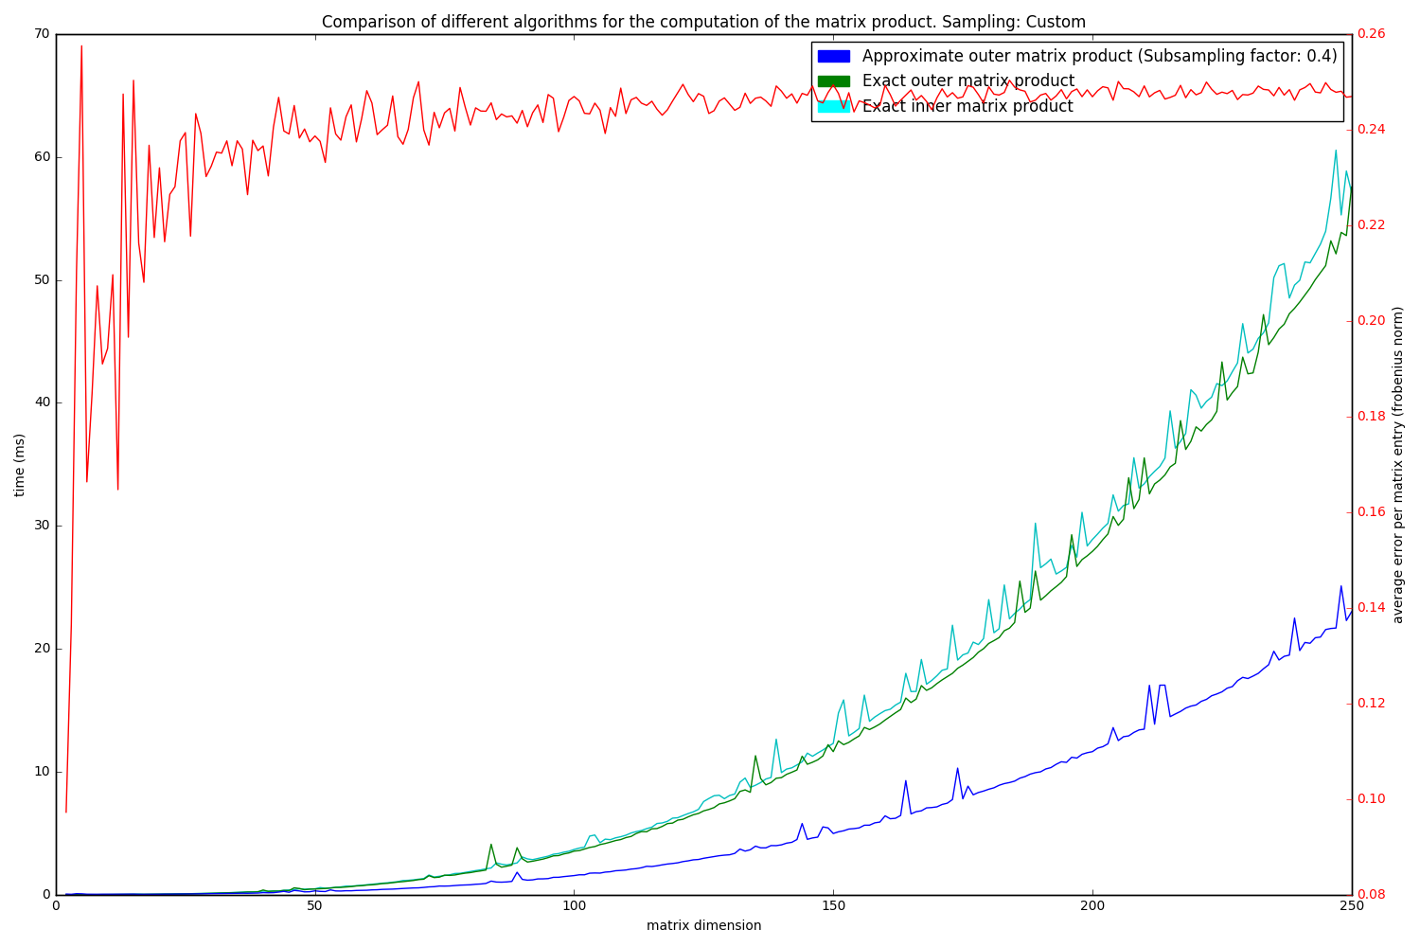
Sampling: Custom
Notes:
Mahesh

Slide 15



Inferences
1.
2.
3.
Notes:
Khushei
2. The second c comes because every term in the summation has the same expectation

Slide 16

Inferences
Use of Frobenius norm to determine closeness of resultant matrix product CR to that of the original product AB
Using the discussed values of p_{i} allows us to bound
; we have a bound on the expected error.
Notes:
Khushei

Slide 17
Time Complexity
Using sampling matrix: O(mn + np) + O(mcp).
Sampling takes O(mn + np) - linear scan for calculating the probabilities, then we have to choose c samples which takes about nc time and then the multiplication of smaller matrices takes mcp time.
Notes:
Mugdha

Slide 18
Applications
Various machine learning algorithms employ the use of matrix multiplication, and most of the time the matrices are quite large. Thus this algorithm would prove helpful, especially in terms of time, which is key in ML algorithms.
Low-Rank Approximation
Tensor-Train Decomposition
Approximating PCA(principal component analysis) using random projections
Large Markov Chains
Notes:
Mugdha

Slide 19
Literature Review
<Kannan and Vempala paper>
To sample some columns(s columns, so m x s) from the original m x n matrix
Randomly choosing columns is not good.
Using sampling probabilities proportional to square of length of columns leads to provable error bounds.
Do trials for sampling from a matrix A of order m x n. In each trial, we pick a random X belonging to {1,2,...,n} with Pr(X=j)=pj. We define pj =|A(:, j)|²/ (Frobenius norm(A))² , for j = 1, 2, . . . , n.
<Halko, Martinsson and Tropp paper>
Central role in data analysis and scientific computing.
The input matrix is compressed to a subspace, either implicitly or explicitly; the subspace determined by the previously discussed sampling method.
Approach beats classical competitors in terms of robustness, speed.

Slide 20
Literature Review
<Mahoney paper>
Elaborate explanation.
Well-divided into sections, covering all topics.
Algorithm is outlined.
<Videos>
For our own understanding.
Randomized algorithms do not work for single matrices.
Statistical evidence to predict the algorithm’s quality control parameters(error), mean and variance.

Slide 21
Thank you!

